Slide 1



Self-Supervised Learning
The Next Step Toward AI
Presented by
Sonal Kumar
Research Scholar, CSE, IIT Guwahati
Supervised by Prof. Arijit Sur & Dr. Rashmi Dutta Baruah
Winter School 2025 @ IIT Guwahati
Supported by TIDF IITG
Organised by Multi Media Lab, IITG

Slide 2
What is Learning ?

Slide 3
What is Learning ?
In General Sense:
The process of acquiring knowledge, skills, behaviors, or understanding through experiences, study, or being taught.
From the perspective of artificial intelligence (AI):
The process by which an AI system improves its performance on a task over time by extracting patterns or knowledge from data.
Can learn with or without the supervision

Slide 4
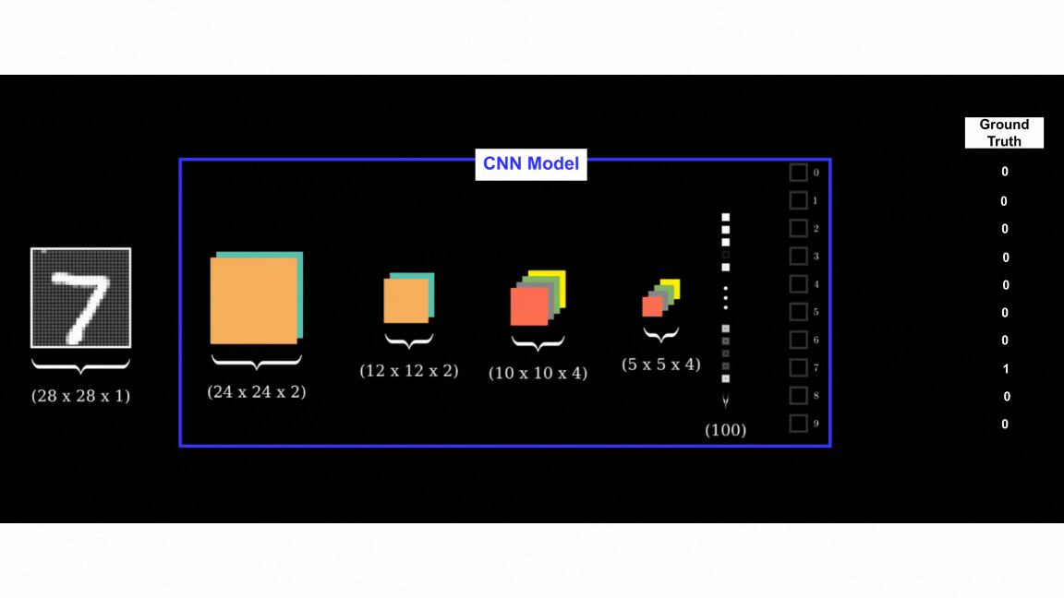
Supervised Training of a CNN Model
A deep learning model needs some kind of supervision for efficient training.
Y = WX + B; X (Input data), Y (Labels/Annotations)

Slide 5
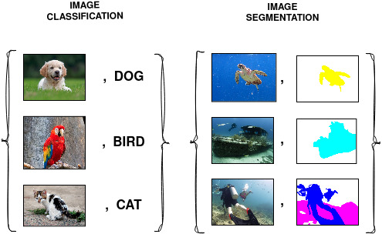
What is Supervision ?
IMAGE CLASSIFICATION:
IMAGE AND CLASS LABEL PAIR
SEMANTIC SEGMENTATION:
IMAGE AND SEGMENTATION MASK PAIR
Given a task and enough labels, supervised learning can solve it really well.
Good performance usually requires a decent amount of labeled samples.

Slide 6
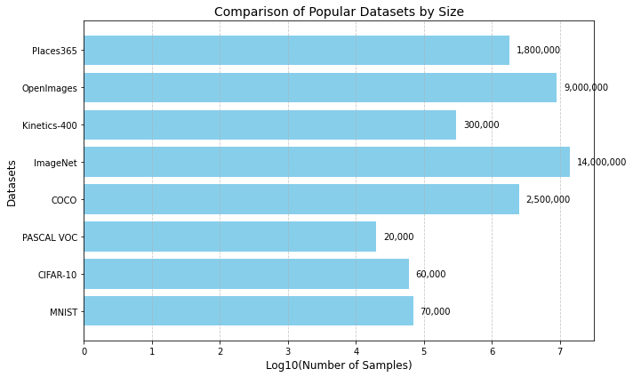
Challenges and Limitations of Supervised Learning
Annotation of large scale dataset is:
Time consuming,
Cost ineffective, and
Hard to be scaled up
Inflexibility in Adapting to New Data
Poor Performance in Complex or Unseen Tasks
High Dependency on Human Expertise
“Supervised learning is a bottleneck for building more intelligent generalist models that can do multiple tasks and acquire new skills without massive amounts of labeled data.”
-Yann LeCun, Ishan Misra (Facebook AI)

Slide 7
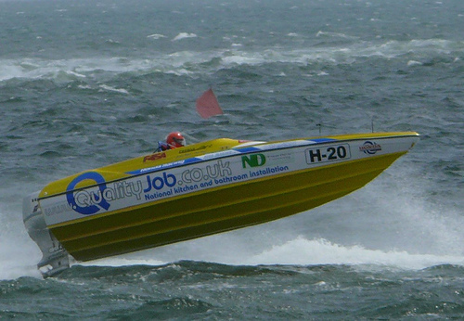
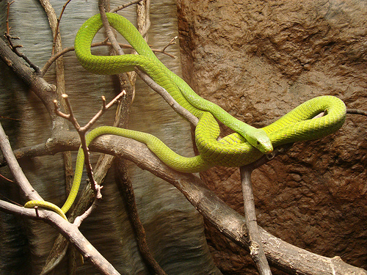
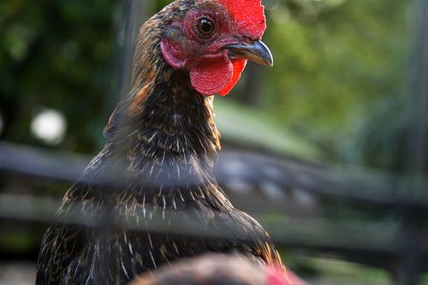
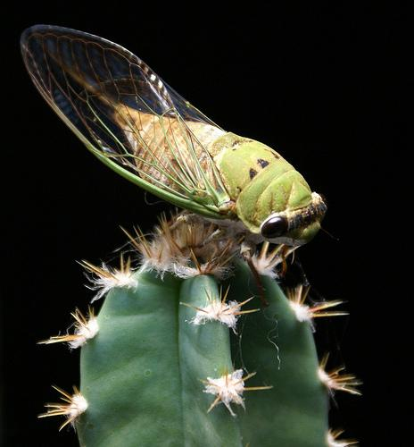
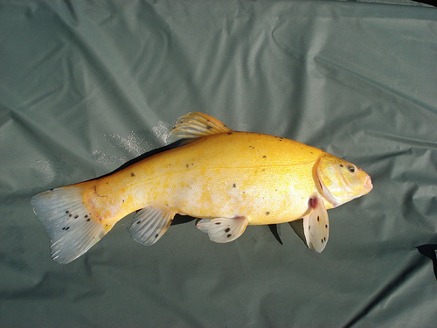
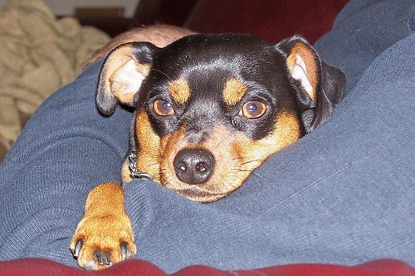
Unsupervised Learning
Learning without the labels or human annotations.
An example:
unlabeled Image Dataset

Slide 8
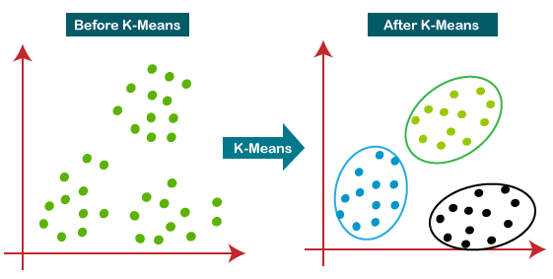
Unsupervised Learning
Learning without the labels or human annotations.
An example is K-means Clustering ( A ML Algorithm to group unlabeled data)

Slide 9
Unsupervised Learning
Learning without the labels or human annotations.
An example is K-means Clustering ( A ML Algorithm to group unlabeled data)
NOT A LEARNING METHOD

Slide 10
Unsupervised Training of a DL Model
No Label —--------> No Supervision —------------> No Training
A deep learning model needs some kind of supervision for efficient training.

Slide 11
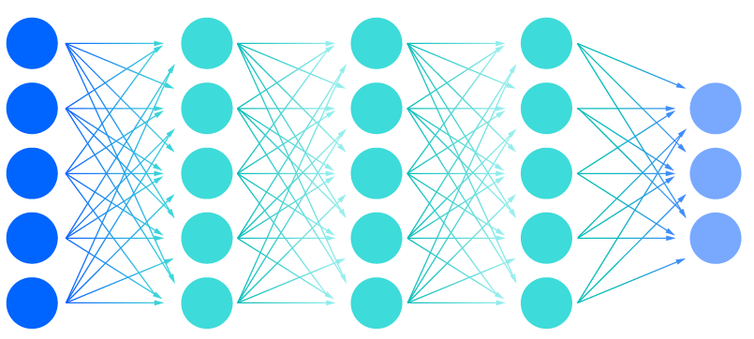
Unsupervised Training of a DL Model
No Label —--------> No Supervision —------------> No Training
How to train a deep learning model with unlabeled data ?
&
unlabeled Image Dataset
Deep Learnng Model

Slide 12
Unsupervised Training of a DL Model
No Label —--------> No Supervision —------------> No Training
Self-supervised Learning: An unsupervised way of training a deep learning model.
How to train a deep learning model in unsupervised setting ?
Generate supervisory signal from the unlabeled dataset itself.
Supervisory signal as one of the properties of the unlabeled dataset.

Slide 13
Self-supervised Learning (SSL)
Leverages inductive bias to guide the learning process.
An example of SSL is Grayscale Colorization.
Inductive biased: Color channels are highly correlated in RGB images, provide complementary information about same object.
Inductive bias is an assumption or prior about the unlabeled data like color, rotation, spatial or temporal information.

Slide 14
Self-supervised Learning
Problem Statement: Given an unlabeled image dataset and a deep learning model, the aim is to learn the meaning of feature representations without labels.
&
unlabeled Image Dataset
Deep Learning Model
Feature representation of an image is a vector or feature map that captures the essential feature or characteristic of that input image.

Slide 15
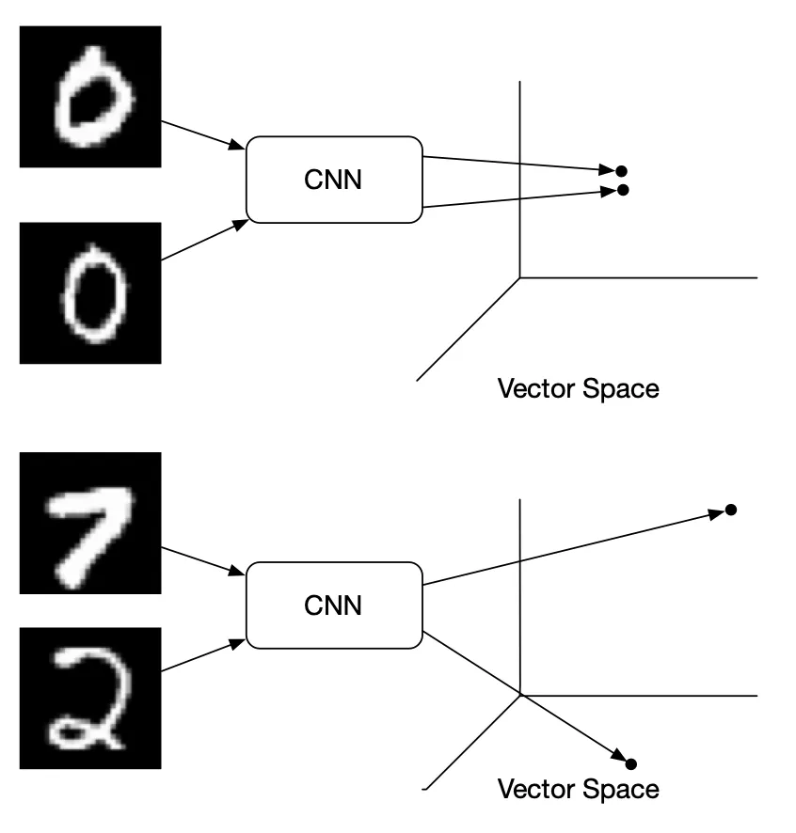
[ 0.12, 0.21, 0.33, ……………………………………………..]
[ 0.11, 0.22, 0.33, ……………………………………………..]
[ 0.23, 0.12, 0.41, ……………………………………………..]
[ 0.66, 0.51, 0.11, ……………………………………………..]
Feature representation of an image is a vector or feature map that captures the essential feature or characteristic of that input image.

Slide 16
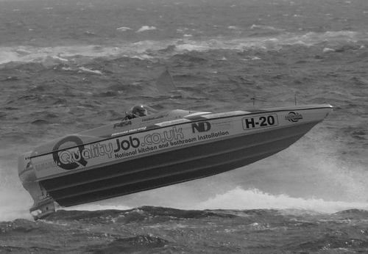
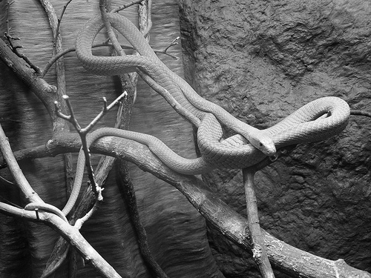
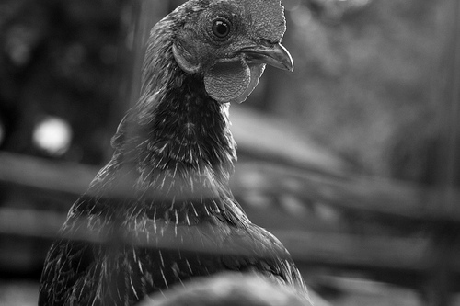
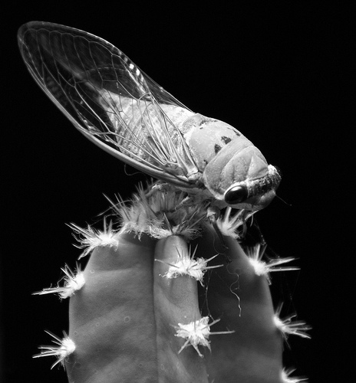
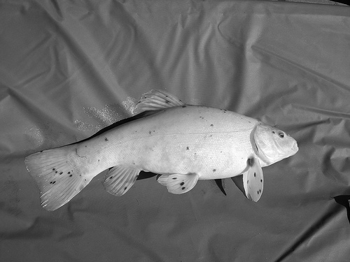
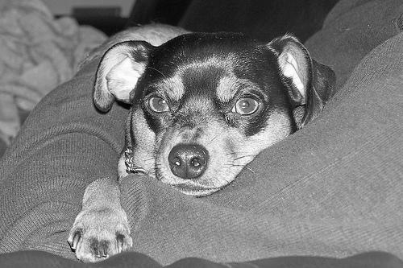
Grayscale Colorization: A pretext Task
(Self-supervised Training)
Step 1: Obtain the grayscale image of each RGB image in dataset.
Image processing
Color Images
Grayscale Images

Slide 17
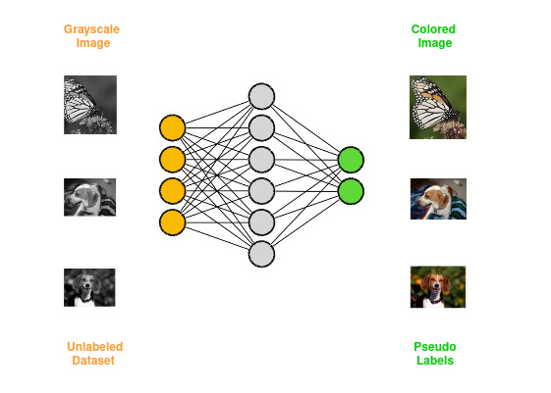
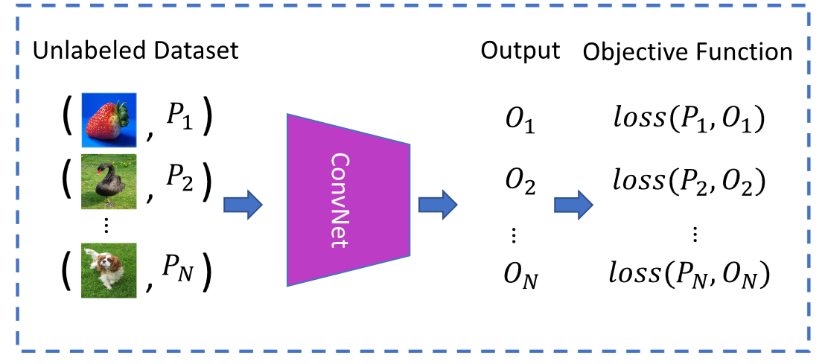
Grayscale Colorization: A pretext Task
Step 2: Train the deep learning model to color input grayscal image.
Pretext tasks are pre-designed tasks for networks to solve, and visual features are learned by learning objective functions of pretext tasks.

Slide 18
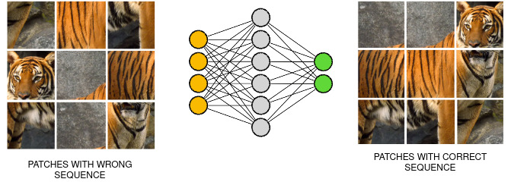
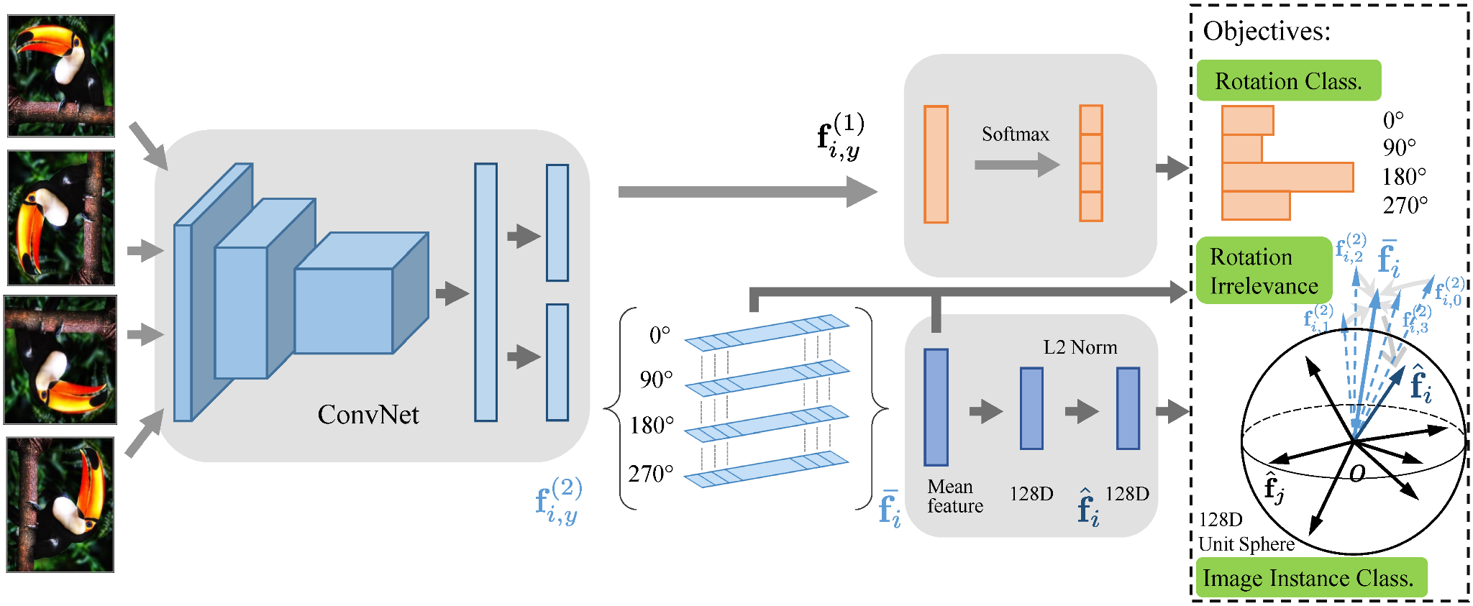
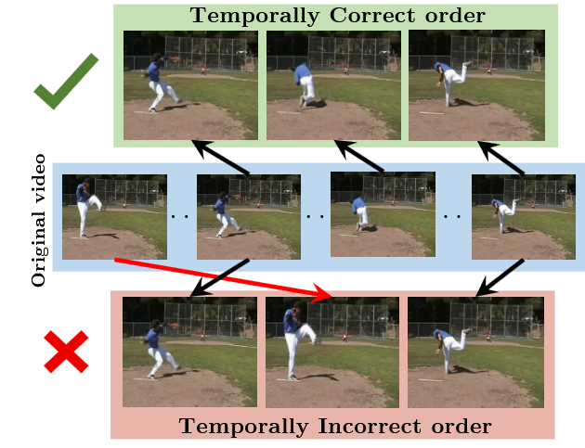
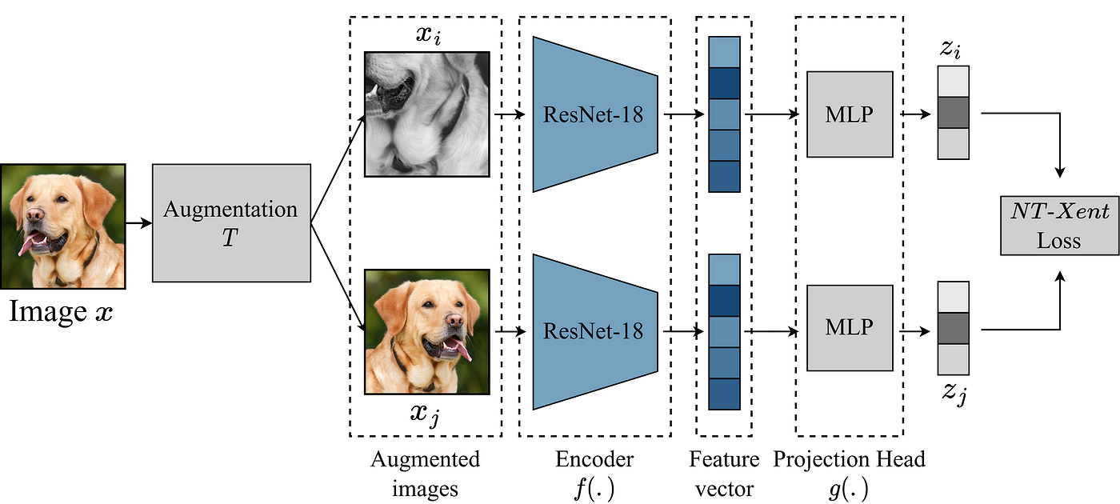
Pretext Task
JIGSAW PUZZLE
RATATION PREDICTION
VIDEO FRAME ORDER PREDICTION
CONTRASTIVE LEARNING

Slide 19
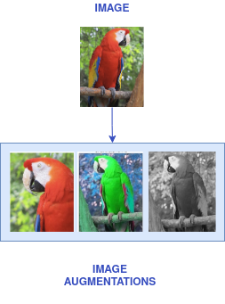
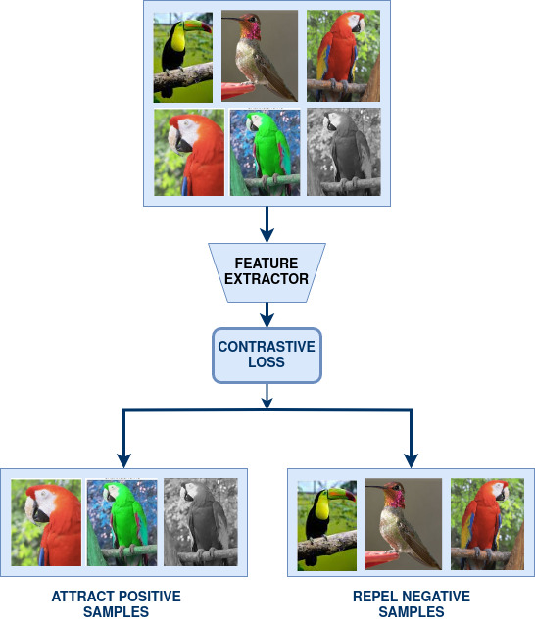
Contrastive Learning

Slide 20
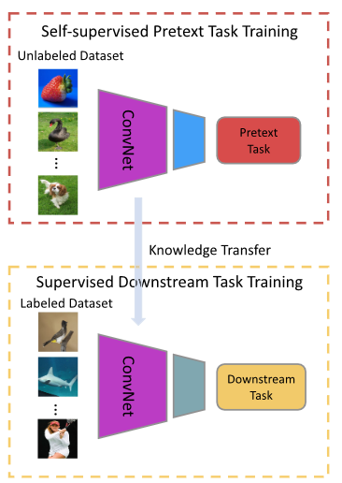
How to use Pretrained SSL Model for Downstream Tasks?
Downstream tasks are computer vision applications like:
Image Classification,
Image Clustering,
Semantic Segmentation,
Object Localization, etc.
These applications can greatly benefit from the pre-trained models when training data are scarce.
Transfer Learning

Slide 21
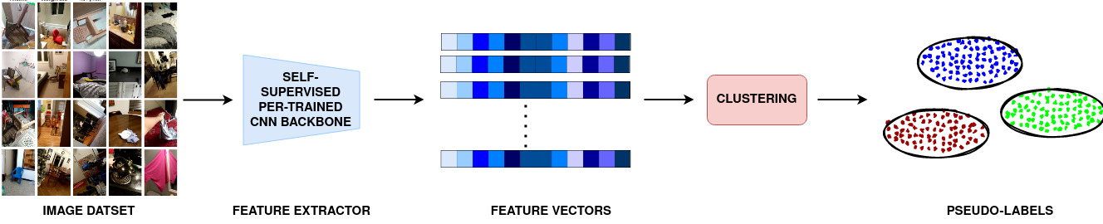
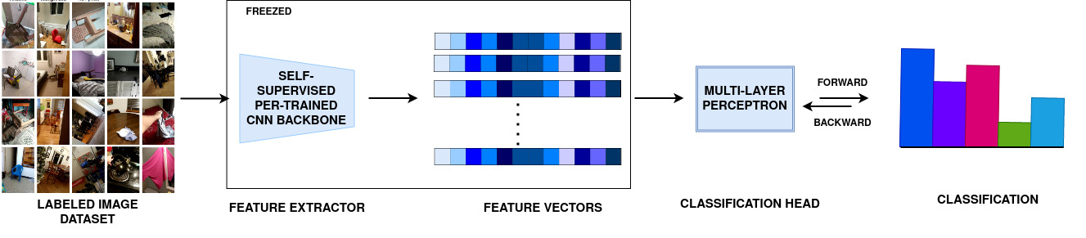
Image Classification & Clustering as Downstream Tasks
IMAGE CLUSTERING
IMAGE CLASSIFICATION

Slide 22
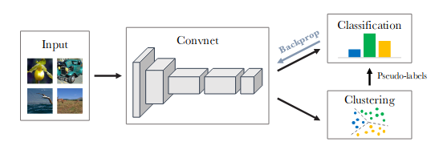
End-to-end Self-supervised Training
Jointly learns the parameters of a neural network and the cluster assignments of the resulting features.

Slide 23
Advantage of Learning with unlabeled Data
Unlabeled data is widely available in most domains.
Removes or reduces labeling time and cost.
Leading to better generalization across various downstream tasks and domain.
Mitigate human bised introduced during labeling by learning directly from raw data.
Unlabeled data can reveal hidden patterns, clusters, or relationships in the data.
Can make use of both labeled and unlabeled portion of data.
Better performance on rare or Imbalanced Classes.
Improve learning across multiple modalities (e.g., text, image, audio).
Good for continual learning setup where the model adapts to new data over time.

Slide 24
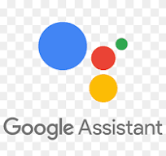


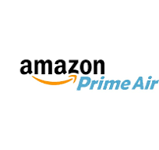

Real time applications of Self-supervised Models
Conversational AI tools: ChatGPT
Personal assistants: Siri, Alexa, Google Assistant
Code auto-completion tools: GitHub Copilot
Text Summarization tools: Notion, Grammarly
Facial Recognition and Biometric Systems: Apple ID
Noise suppression in video calls: Zoom, Microsoft Teams
Delivery drones: Amazon Prime Air
Visual search tools: Google Lens
AI art generation: DALL-E
Content moderation and creation tools: Canva AI

Slide 25
Conclusion
Supervised learning is a bottleneck for building more intelligent generalist models.
SSL unlocked the true potential of artificial intelligence by learning with raw data.
It bridges the gap between unsupervised learning and supervised learning.
SSL is reshaping machine learning by making it more efficient, scalable, and adaptable
"Machines that learn from unlabeled data are the key to scaling intelligence in the real world."

Slide 26
Referances
Jing, L. and Tian, Y., 2020. Self-supervised visual feature learning with deep neural networks: A survey. IEEE transactions on pattern analysis and machine intelligence, 43(11), pp.4037-4058.
Caron, M., Bojanowski, P., Joulin, A. and Douze, M., 2018. Deep clustering for unsupervised learning of visual features. In Proceedings of the European conference on computer vision (ECCV) (pp. 132-149).
Self-supervised learning: The dark matter of intelligence
Weng, L. (2019, November 10). Self-supervised learning. Retrieved from https://lilianweng.github.io/posts/2019-11-10-self-supervised/
Hands on SSL: https://colab.research.google.com/drive/1Z9Zax5hTxgp1FtwOOwOiJ6ShEFW5zf4A?usp=share_link#scrollTo=M9jpzeHA6Hh1

Slide 27
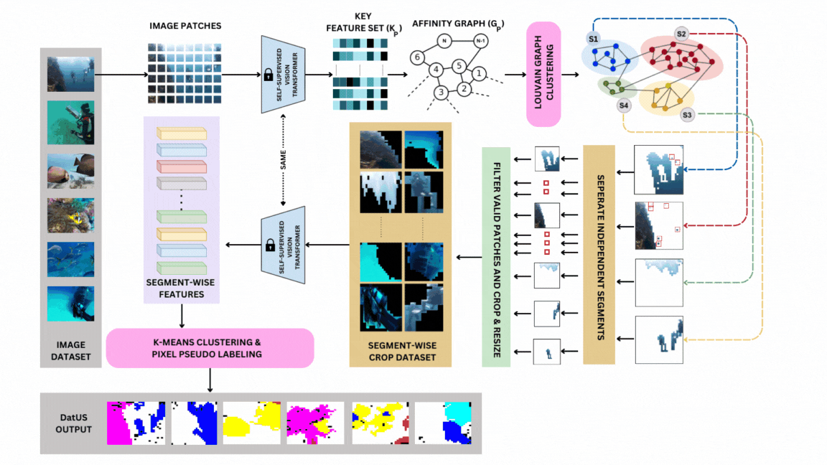
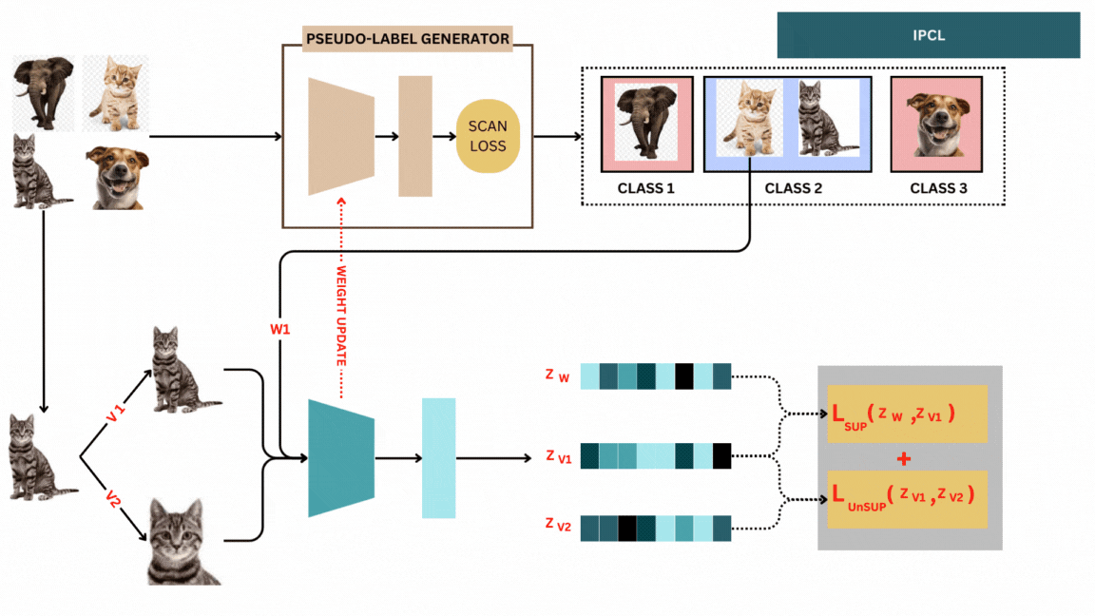
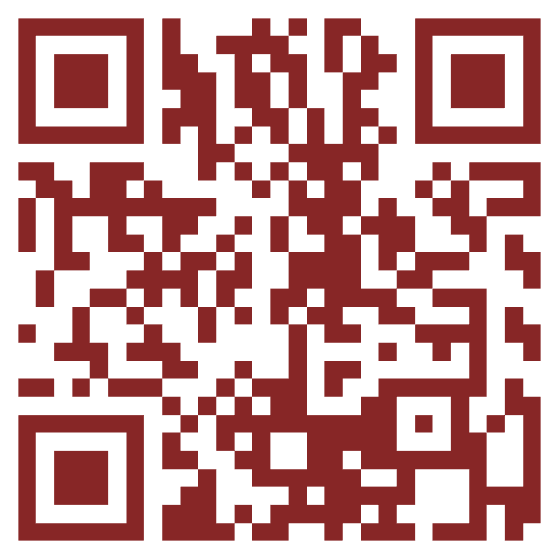
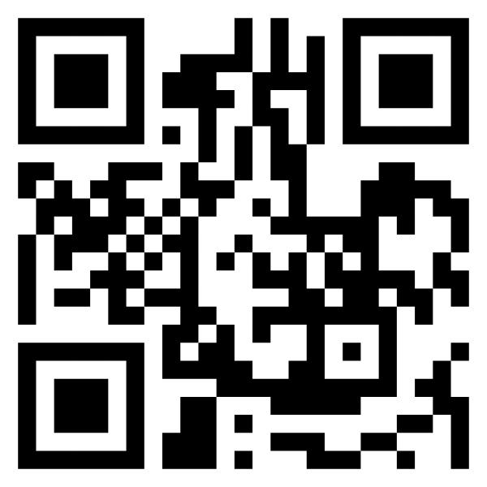
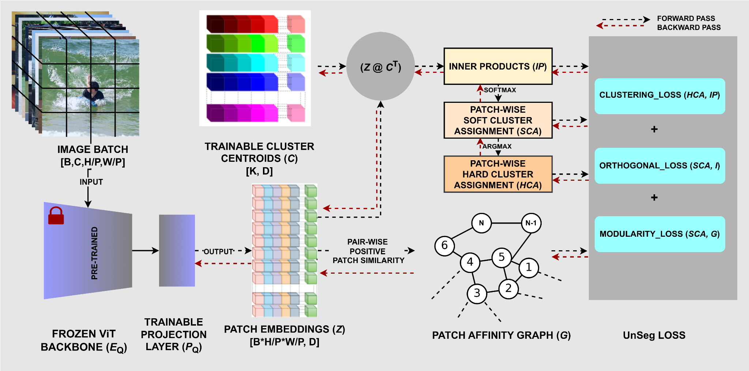
Our Research @ Self-supervised Learning
THANK YOU
ANY QUESTIONS ?
DatUS
IEEE TRANSACTION
IPCL
ICASSP 2024
LinkedIn
GitHub
GraPix
ICPR 2024

Slide 28
THANK YOU
ANY QUESTIONS ?
LinkedIn

